Slide 1
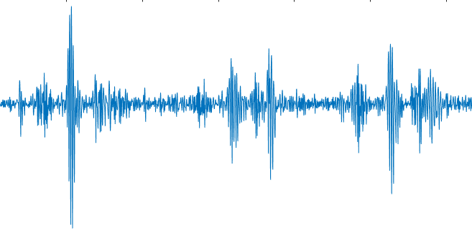
Fetal Heart Rate Processing

Slide 2
Ultrasound Project Goals
Characterize and quantify fetal behavioral response to maternal voice and other auditory stimuli
Determine differences in behavioral response between infants who develop ASD, high-risk infants who do not develop ASD, and controls
To relate differences in fetal behavior to differences in postnatal behavior

Slide 3
Fetal HR Indicates Behavior
Heart rate patterns help define the 4 behavioral states in mid-late term fetuses
Levels of activity and wakefulness
HR Accelerations - Startle response
HR Decelerations - Orienting response
Indicates attention→ fetus can distinguish between and prefer certain stimuli
FHR variability (beat-to-beat variation) as another measure of behavior and well-being

Slide 4
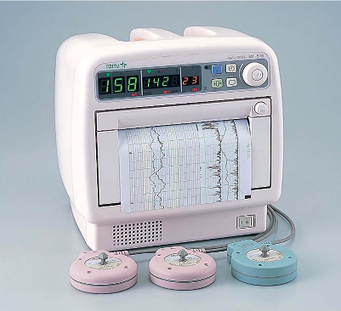
FHR Measurement
Typically measured by Cardiotograph (CTG) using Doppler ultrasound
Detects movement via Doppler effect
TOITU Actocardigram measures raw heartbeat signal and somehow converts to a heart rate tracing
How to reliably convert raw heartbeat signal into the heart rate?

Slide 5
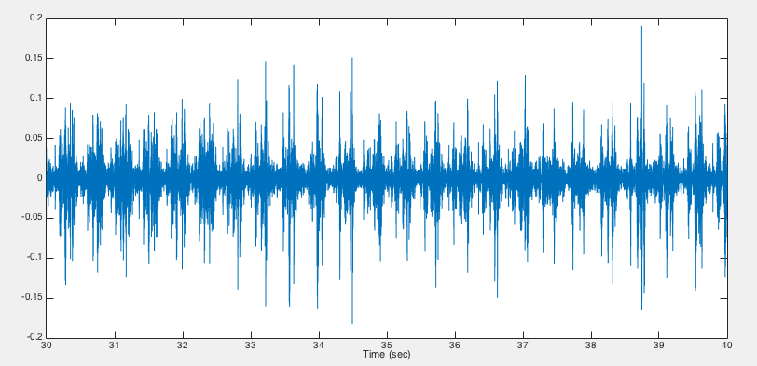
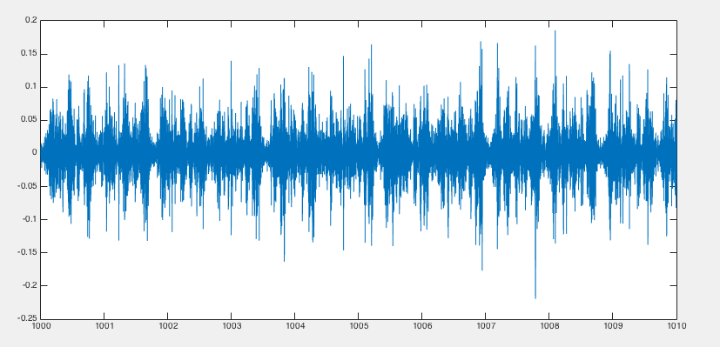

FHR Signal
Region with interference
Clean region

Slide 6
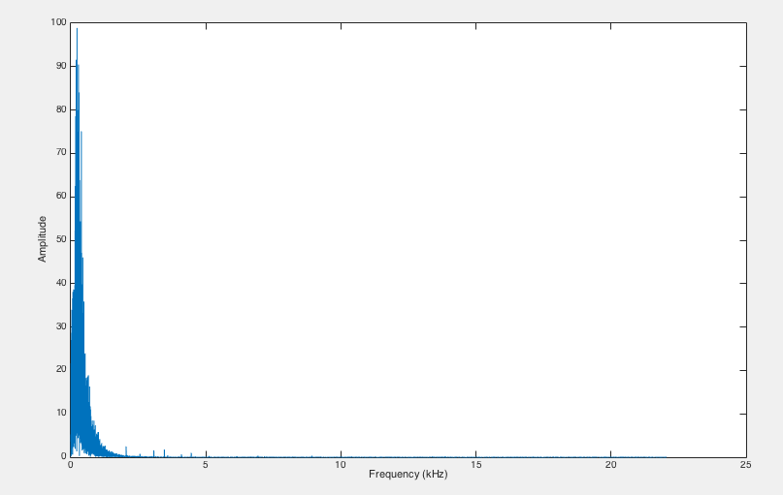
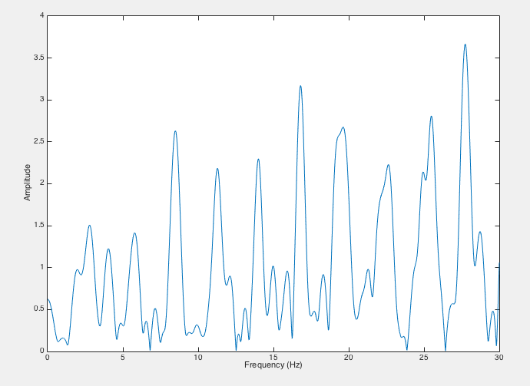
FHR Spectral Analysis
Fourier transform vs. Chirp z transform (czt)

Slide 7
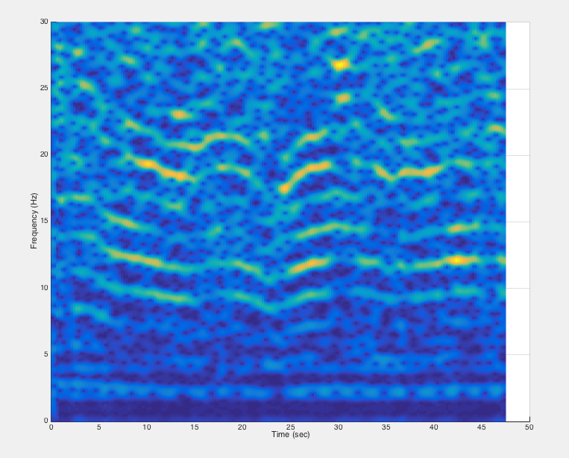
CZT Spectrogram
Spectrums of overlapping windows of fixed length (2.5 sec)
Window parameters affect resolution & accuracy
Missing heart rate fundamental frequency (around 2-3 Hz ~ 120-180 bpm)
Periodic harmonic bands

Slide 8
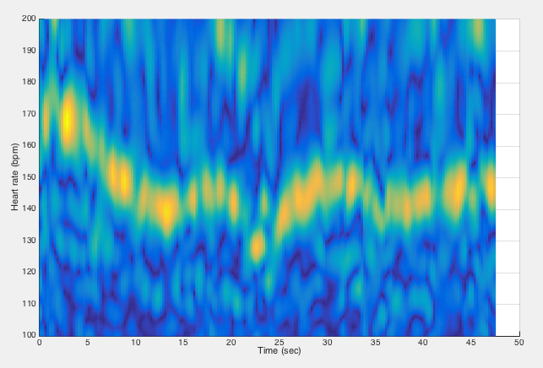
HR Spectrogram
Spectrum of the spectrum gives frequency of harmonic bands
HR = 60*freq_{fund} = 60*λ_{harm} = 60/freq_{harm}

Slide 9
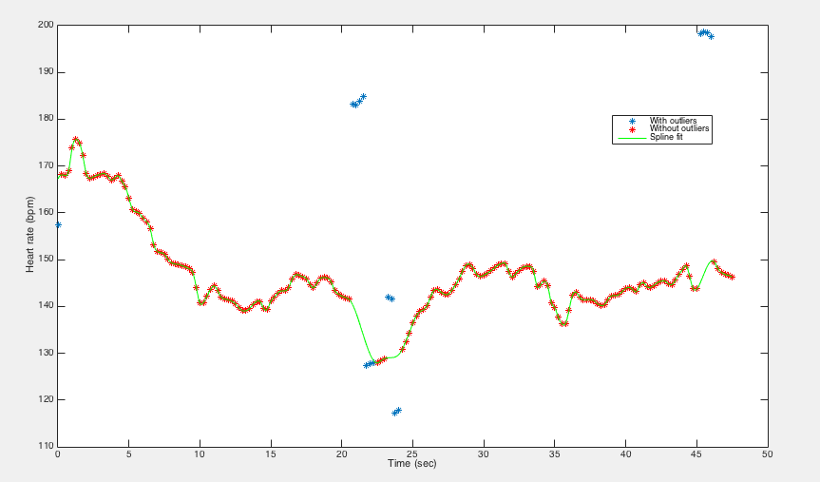
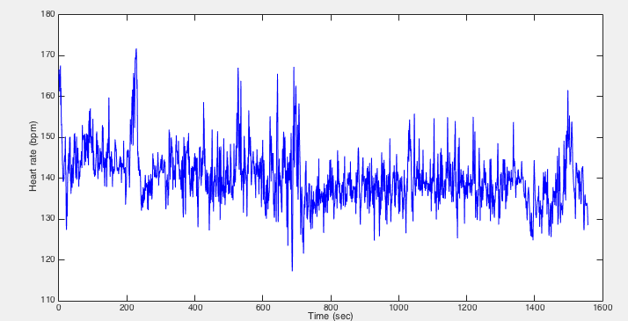
Peak Picking, Outlier Removal, & Spline Fitting

Slide 10
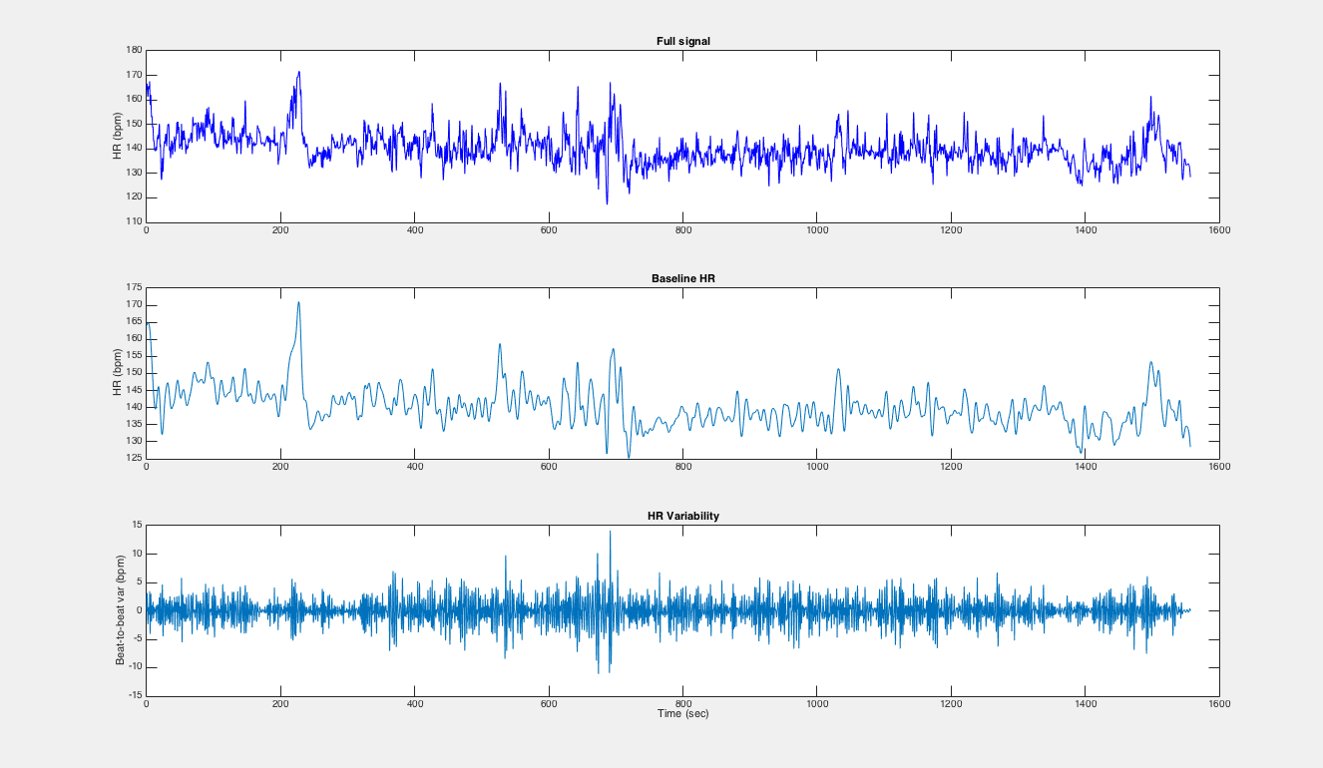
Filtering FHR

Slide 11
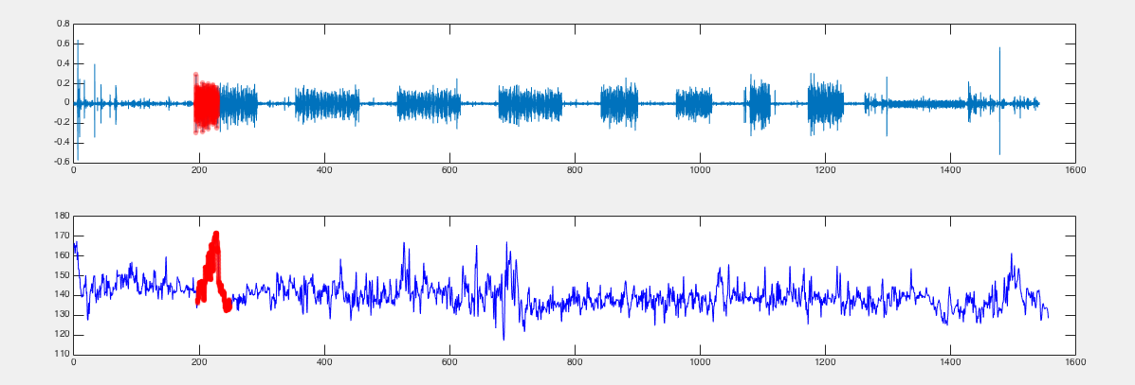
Maternal Voice

Slide 12
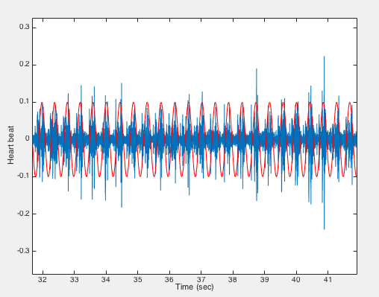
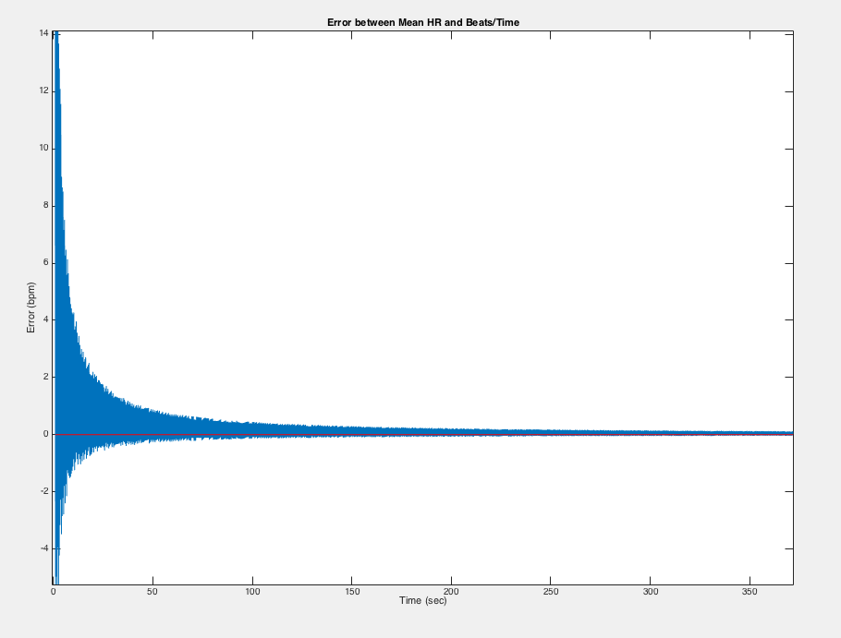
Back to Heart Beats

Slide 13
Next Steps
Making FHR baseline and FHR variability extraction real-time
Look for quantitative differences in HRV and startle/orienting responses over entire dataset
Improve spectral accuracy with multi-taper analysis
Quantifying error and comparing with other FHR extraction techniques

